Slide 1
Presentation 23
Quality management standards
The benefits of use of standards
The organizations involved in standards
development
The classification of standards
The scope of quality management standards
ISO 9001 and ISO 9000-3
Certification according to ISO 9000-3
Capability Maturity Models
The SPICE project and the ISO/IEC 15504
software process assessment standard

Slide 2
The benefits of use of standards
* The ability to apply methodologies and procedures of the highest professional level.
* Better mutual understanding and coordination among development teams but especially between development and maintenance teams.
* Greater cooperation between the software developer and external participants in the project.
* Better understanding and cooperation between suppliers and customers, based on the adoption of standards as part of the contract.

Slide 3
Classes of SQA
standards - comparison
Characteristics | Quality Management Standards | Project Process Standards
The target unit | Management of software development and/or maintenance and the specific SQA units | A software development and/or maintenance project team
The main focus | Organization of SQA systems, infrastructure and requirements | Methodologies for carrying out software development and maintenance projects
Standard’s objective | “What” to achieve | “How” to perform
Standard's goal | Assuring supplier’s software quality and assessing its software process capability | Assuring the quality of a specific software project’s products

Slide 4
Organizations involed in
SQA standards development
Most prominent developers of SQA standards:
<> IEEE (Institute of Electric and Electronic Engineers) Computer Society
<> ISO (International Standards Organization)
<> DOD (US Department of Defense)
<>ANSI (American National Standards Institute)
<> IEC (International Electrotechnical Commission)
<> EIA (Electronic Industries Association)

Slide 5
The scope of quality
management standards
Certification standards
* Enable a software development organization to demonstrate consistent ability to assure acceptable quality of its software products or maintenance services. Certification is granted by an external body.
* Serve as an agreed-upon basis for customer and supplier evaluation of the supplier’s quality management system. Accomplished by performance of a quality audit by the customer.
* Support the organization's efforts to improve its quality management system through compliance with the standard’s requirements.

Slide 6
The scope of quality
management standards
Assessment standards
* Serve organizations as a tool for self-assessment of their ability to carry out software development projects.
* Serve for improvement of development and maintenance processes by application of the standard directions
* Help purchasing organizations determine the capabilities of potential suppliers.
* Guide training of assessor by delineating qualifications and training program curricula.

Slide 7
ISO 9000-3 principles
Customer focus
Leadership
Involvement of people
Process approach
System approach to management
Continual improvement
Factual approach to decision making
Mutually supportive supplier relationships

Slide 8
ISO 9000-3 - Requirements
classification
Requirement Subjects | Requirement Subjects
4. Quality management system | 4.1 General requirements 4.2 Documentation requirements
5. Management responsibilities | 5.1 Management commitments 5.2 Customer focus 5.3 Quality policy 5.4 Planning 5.5 Responsibility, authority and communication 5.6 Management review
6. Resource management | 6.1 Provision of resources 6.2 Human resources 6.3 Infrastructure 6.4 Work environment
7. Product realization | 7.1 Planning of product realization 7.2 Customer-related processes 7.3 Design and development 7.4 Purchasing 7.5 Production and service provision 7.6 Control of monitoring and measuring devices
8. Measurement, analysis and improvement | 8.1 General 8.2 Monitoring and measurement 8.3 Control of nonconforming product 8.4 Analysis of data 8.5 Improvement

Slide 9
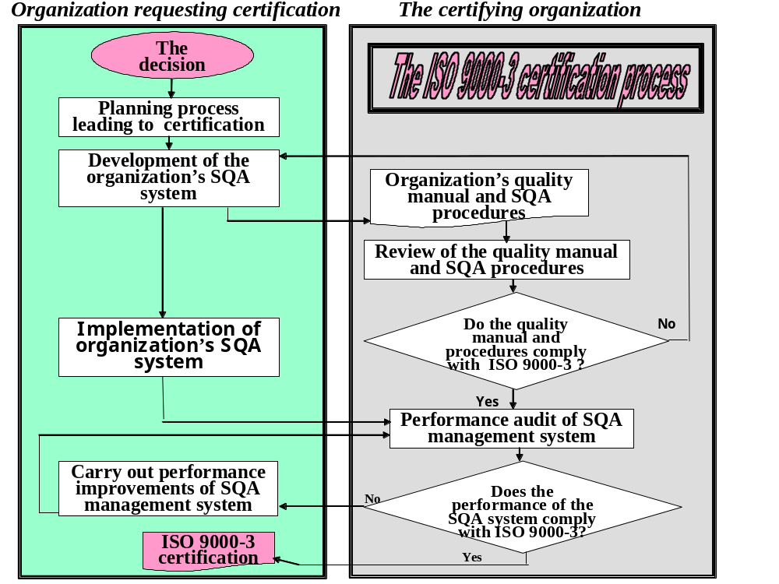

Slide 10
The principles of
CMM assessment
<> Quantitative management methods increases the organization's capability to control the quality and improve the productivity.
<> Application of the five-level capability maturity model that enables to evaluate the achievements and determine the efforts needed to reach the next capability.
<> Generic process areas that define the “what” — not “how” enables the model's applicability to a wide range of implementation organizations:
  -- It allows use of any life cycle model.
  -- It allows use of any design methodology, development tool and
  programming language.
  -- It does not specify any particular documentation standard.

Slide 11
Time required to progress
to the next CMM level
Capability level transition | Mean time (months) | No. of organizations
Level 1 to level 2 | 24 | 125
Level 2 to level 3 | 21.5 | 124
Level 3 to level 4 | 33 | 18
Level 4 to level 5 | 18 | 19
Source: Based on Gartner Inc. (2001)

Slide 12
Project resources distribution
by CMM capability level
The case of Raytheon
Percentage of project resources
CMM capability level | Original work | Reworking | Testing and quality assurance
1 | 34 | 41 | 25
2 | 55 | 18 | 27
3 | 67 | 11 | 22
4 | 76 | 7 | 17

Slide 13
Versions of CMMI (Capability
Maturity Model Integration)
CMMI-SE/SW
  System Engineering CMM (SE-CMM)
  Software engineering CMM (SW-CMM)
CMMI-SE/SW/IPPD/SS
  System Engineering CMM (SE-CMM)
  Software engineering CMM (SW-CMM)
  Integrated Product/Process Development (IPPD-CMM)
  Supplier Sourcing
CMMI-SE/SW/IPPD
  System Engineering CMM (SE-CMM)
  Software engineering CMM (SW-CMM)
  Integrated Product/Process Development (IPPD-CMM)

Slide 14
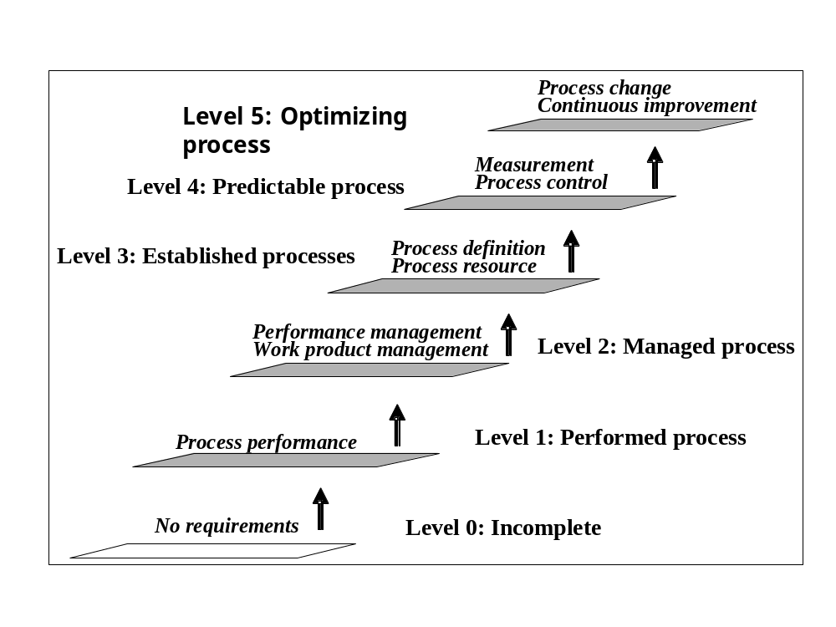
ISO/IEC 15504 process
assessment model

Slide 15
Principles of the ISO/IEC
15504 assessment model
** Harmonize the many existing “independent” assessment methodologies by providing a comprehensive framework model (“what” has to be accomplished rather than “how” it has to be done).
** Be universal to serve all or almost all categories of software suppliers, customers and software categories.
** Be highly professional.
** Aim at reaching international acceptance as world standard. To save suppliers' resources by eliminating the need to perform several different capability assessments in response to different customer requirements.

Slide 16
The goals of the SPICE
project trials
<> To validate the ISO/IEC 15504 model's conformity with current standards.
<> To verify its usability in determining whether software satisfies user requirements.
<> To gain experience in applying the ISO/IEC 15504 model.

